Slide 1
Bicycles-Dawsha Fine Arts
Zero0o..

Slide 2
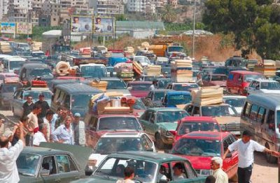
Crowded !!!

Slide 3
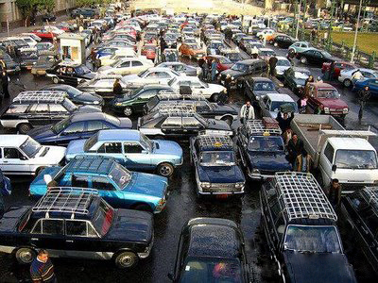
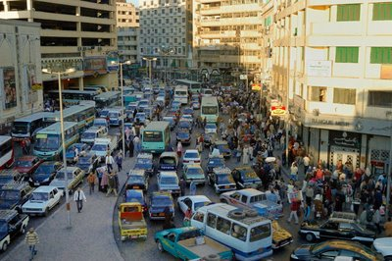
Crowded !!!

Slide 4
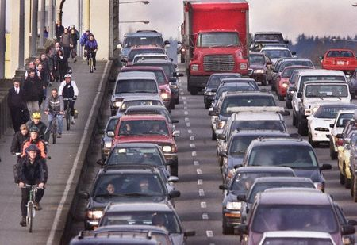
Crowded !!!

Slide 5
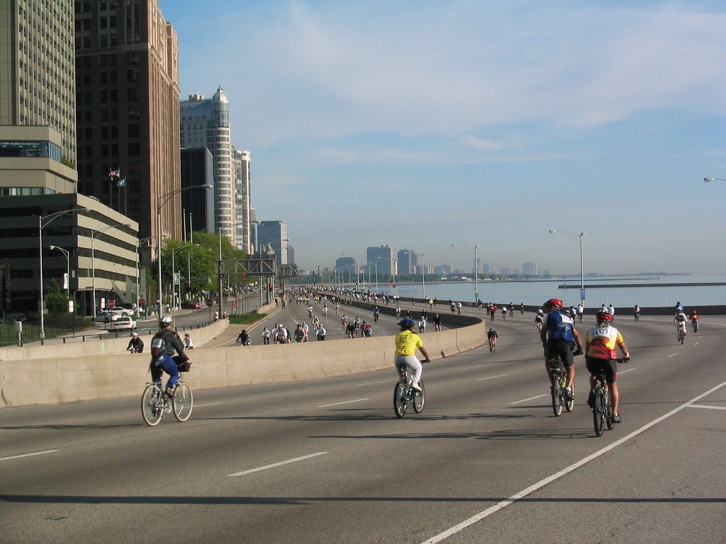
Calm …

Slide 6
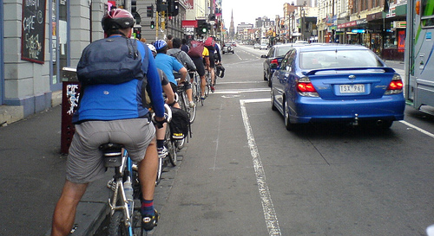
Crowded !!!

Slide 7
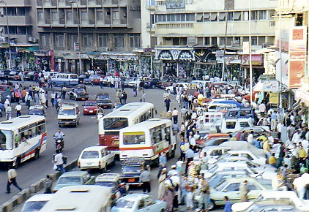
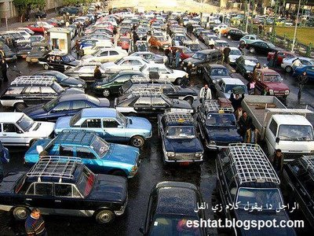
Car Parking!!!

Slide 8
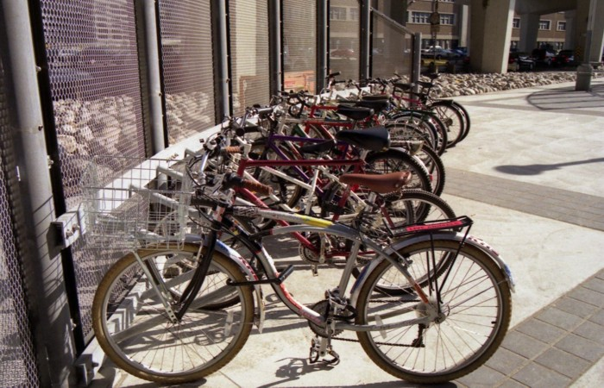
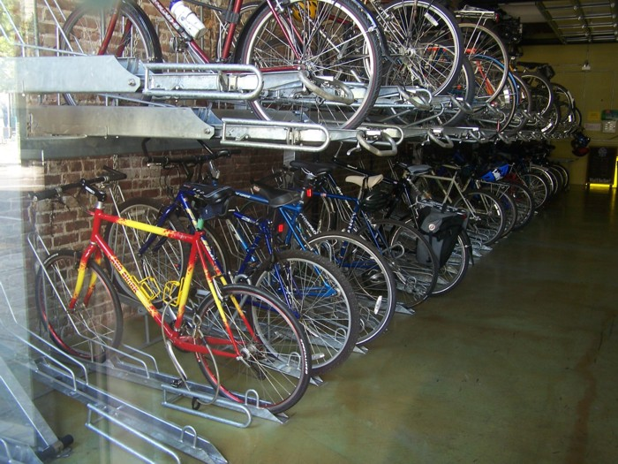
Bicycle Parking…

Slide 9
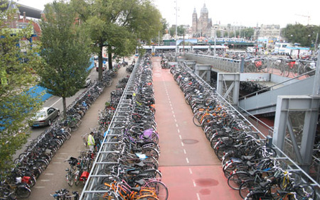
Amsterdam

Slide 10
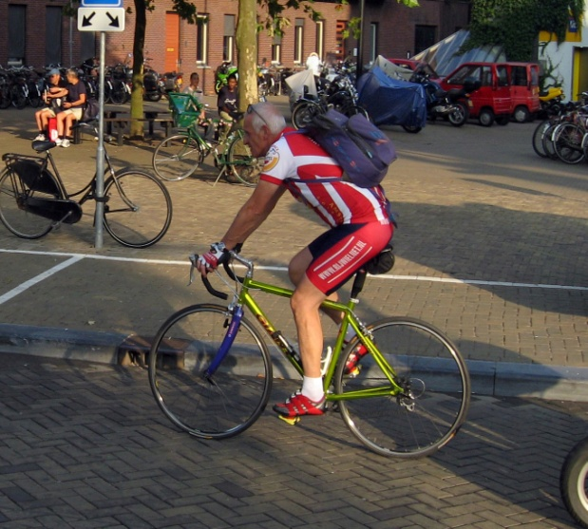
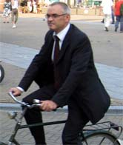
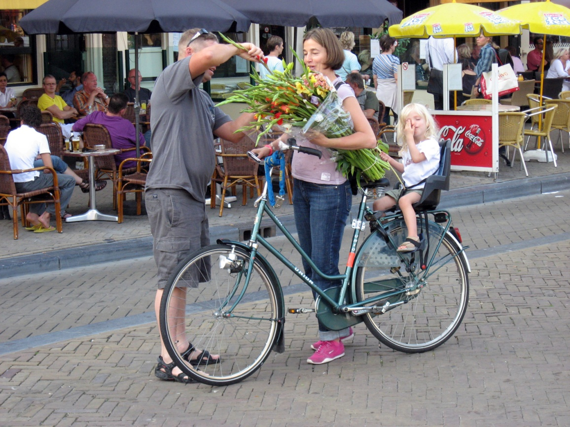
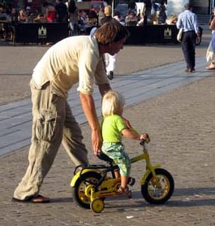
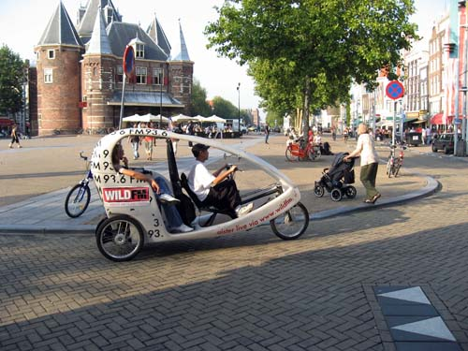
82 pic. In 73 min.

Slide 11
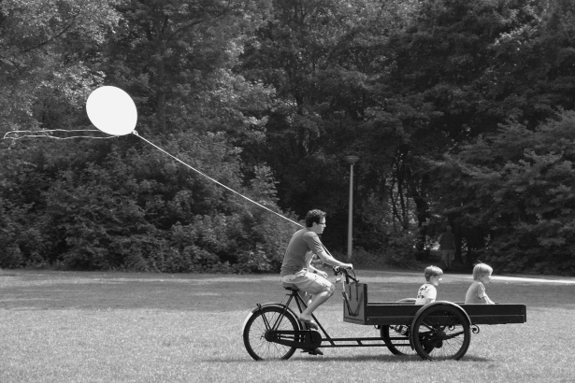
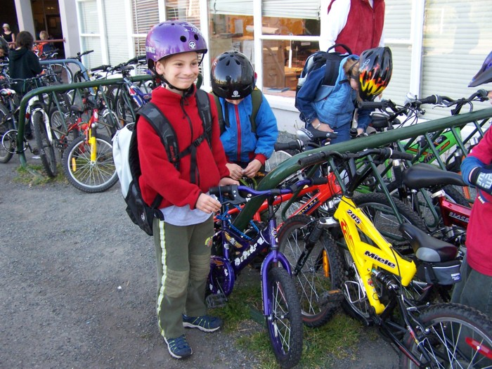
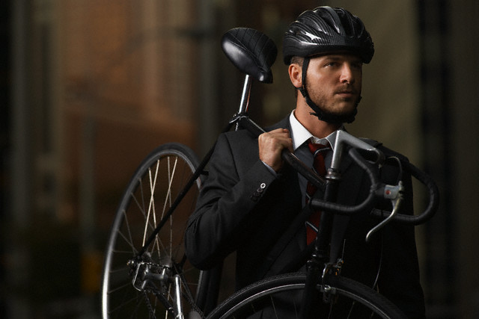

Slide 12
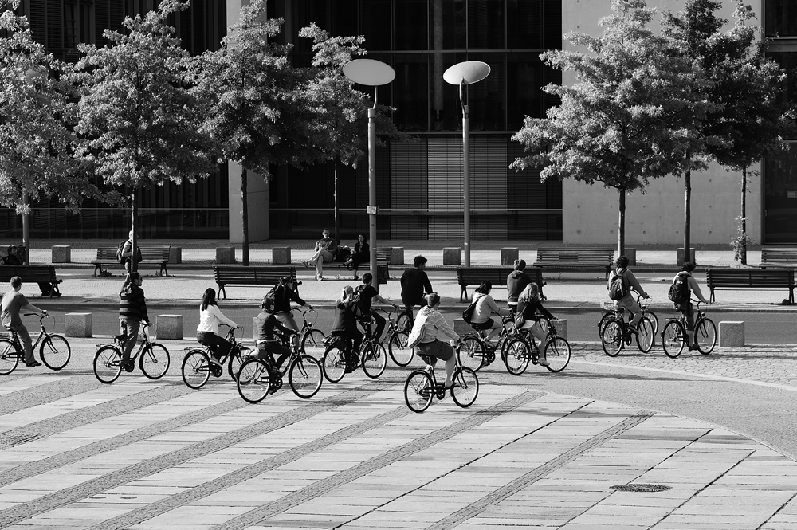

Slide 13
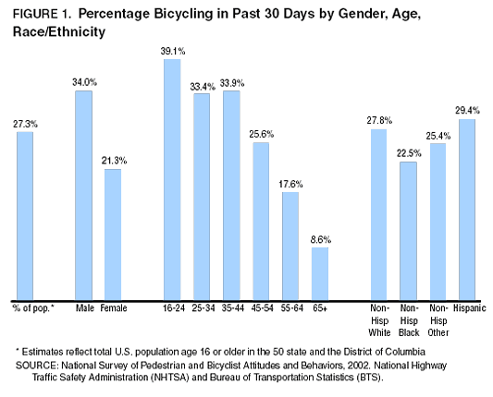

Slide 14
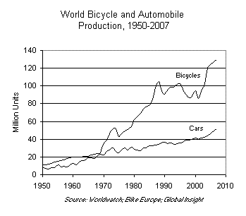

Slide 15
Importance …
Economical.
Physical.
Environmental.

Slide 16
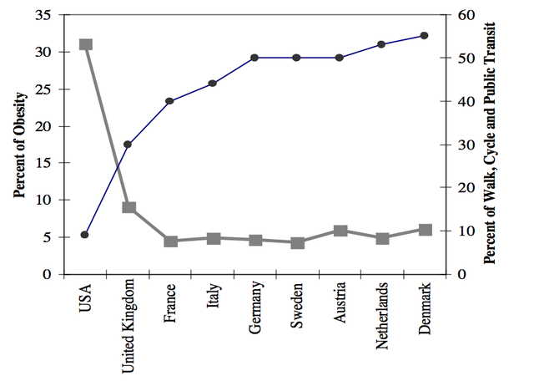

Slide 17
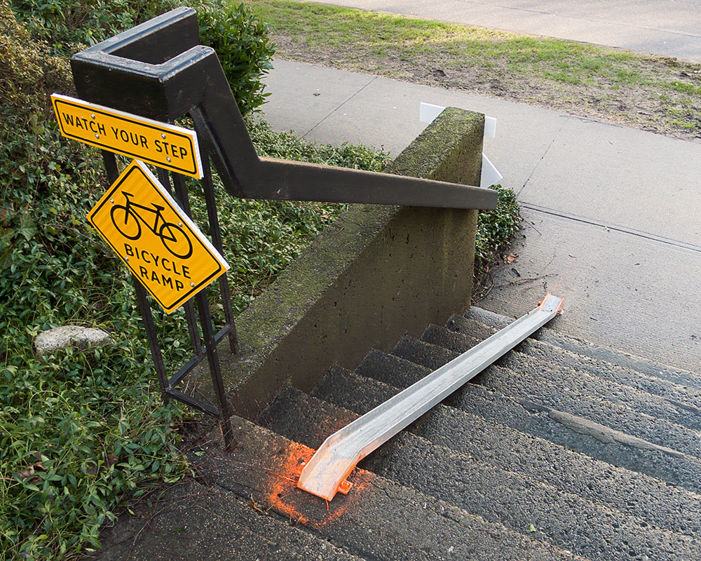

Slide 18
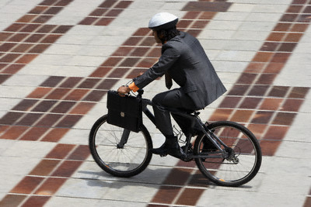

Slide 19
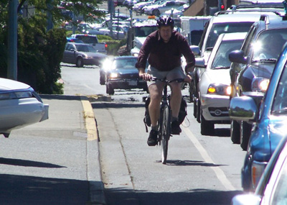

Slide 20
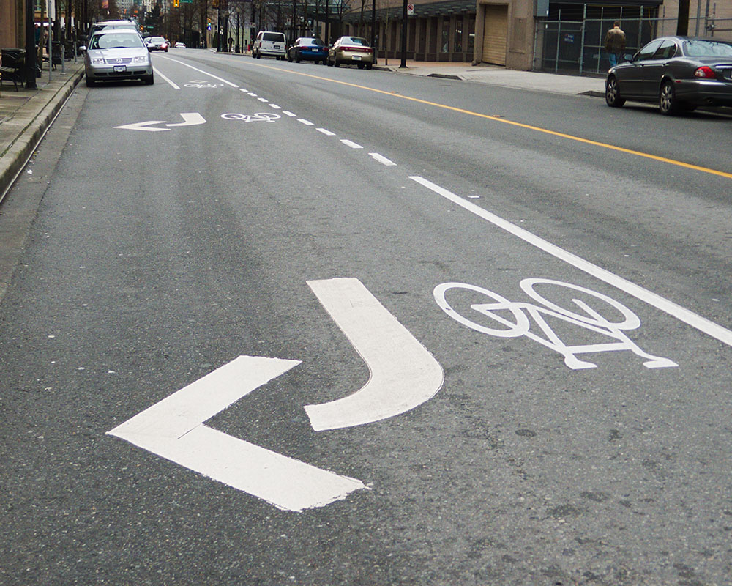

Slide 21
Problems in Egypt
No place for bicycle lane.
Egyptian weather.
Egyptian culture.

Slide 22
Short story…

Slide 23
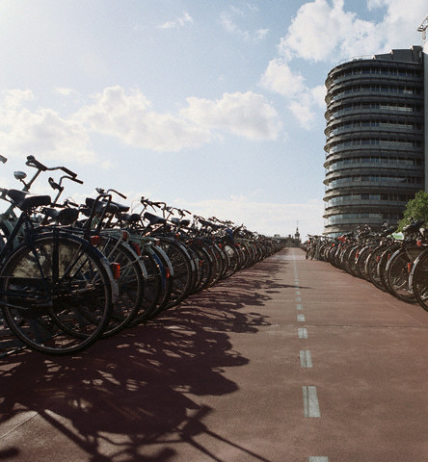

Slide 24
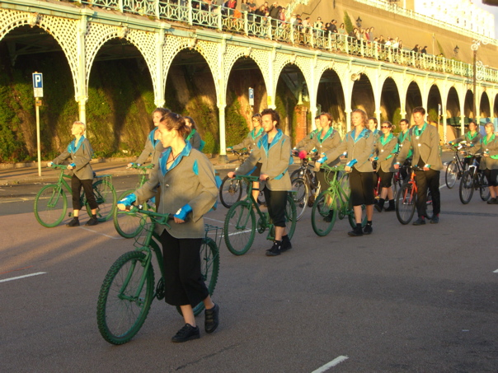

Slide 25
We Want to be like this
Not like this

Slide 26
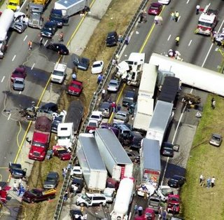
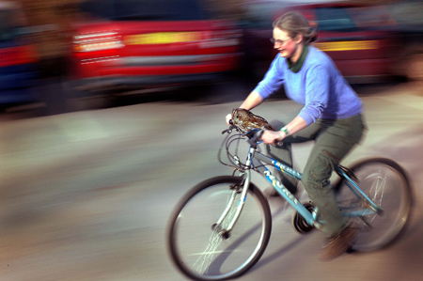
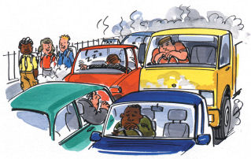
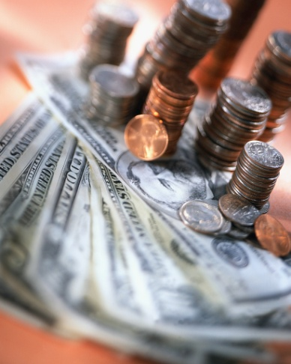
ZeroOo
Zero Crowd
Zero Fat
Zero a turn (لفة)
Zero Pollution
Zero Money

Slide 27
Presented by :-
Fine Arts

Slide 28
Your Views and Suggestions ..

Slide 29
References :-
http://www.totalbike.com/web/articles/commuting.html
http://www.virgin-vacations.com/site_vv/11-most-bike-friendly-cities.asp
http://www.ski-epic.com/amsterdam_bicycles/
http://www.usatoday.com/news/education/2008-08-06-Outofcars_N.htm

